Slide 1
WICA: an extra tool in our Control System Toolkit
Simon Rees :: Software Engineer :: Large Facility Controls Section
PSI Controls Section Lightning Talks November 2022

Slide 2
Introduction
Several years ago a friend of mine working in industry told me:
“the days of the desktop client application are over”
“nobody makes applications that way any more, everything is in the browser”
That got me thinking:
Are we somehow missing a trick at PSI, should we be making controls applications using the web ?
Is our scientific environment so special that we can ignore what’s going on in software engineering elsewhere ?
What would be the benefits and challenges of bringing our control system to the web?
This talk is far too short to present that topic in any detail. Instead I will present briefly my very early experiences looking into this.
Then, to make things more concrete I will present a new tool called WICA.

Slide 3

Sunset on Desktop Client Applications
…we loved you, but is it time to move on ?

Slide 4


Desktop Client Applications – wtf ?
SLS and SwissFEL were designed from the start to use EPICS
HIPA and PROSCAN started with a different control system architecture (ACS) and were migrated to EPICS later
Display Panel
caQtDm
Client Application
Java Swing, C++/Qt,
Python Qt
EPICS IOCs
Intelligence
Intelligence
eg VME, IFC, compact PCI,
SoftIOCs
EPICS IOCs
eg VME, IFC, compact PCI,
SoftIOCs
Sensors
Actuators
Sensors
Actuators
Fat IOC / Thin GUI Client
Thin IOC / Fat GUI Client
=> today’s GUI architectures have been determined by design decisions > 20 years ago !

Slide 5


Control System ➔ Web: an impossible task ?
Control System ➔ Web: a pointless task ?
Control System ➔ Web: an [insert adjective] task ?
…The use of web technologies at PSI has invoked strong feelings on both sides
The web can bring benefits, when used appropriately, but doesn’t come for free
…during the last couple of years I have been looking at some of the trade-offs

Slide 6
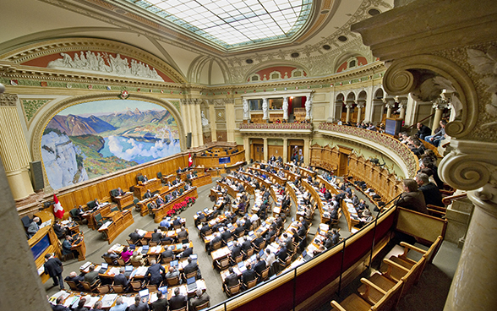
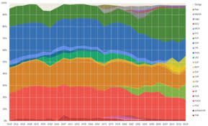
A short interrupt…
…a Party Political Broadcast on behalf of the web community !

Slide 7
Web Project - Benefits
Web technologies offer the leading paradigm for today’s software development. If we ignore them our controls solutions will be perceived as increasingly outdated and stuck in a timewarp ! Or worse, our users may simply choose to go elsewhere.
Richer state-of-the-art UX possibilities are now achievable… animations, sound, speech-synthesis, messaging… can be integrated quickly with powerful libraries.
Web technologies help our on-site staff respond quickly to issues in our facilities.
Web technologies fit the demands of modern society: remote working flexible/hybrid work models; access anywhere on multiple platforms, onsite, whilst travelling, or at home.
Web technologies help our Pikett support staff diagnose faults more quickly and efficiently, reducing down time.
The pool of trained web developers is much larger than the pool of, say, EPICS or TANGO developers. Using web technologies should make our recruitment easier.

Slide 8
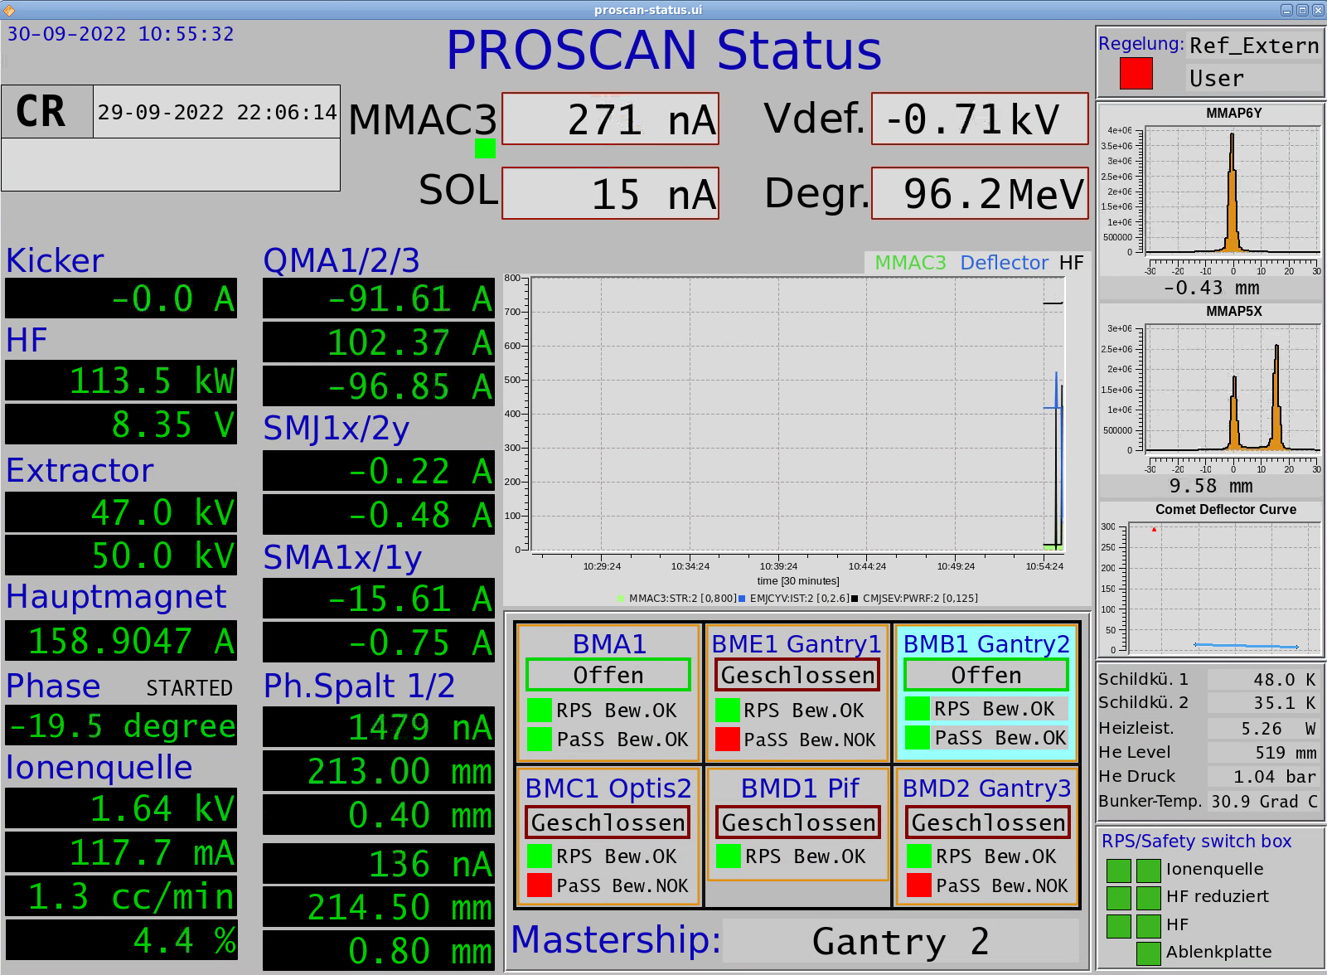
A Pilot Web Project - PROSCAN Status Page
The original display page made with caQtDm
Ugly, but used effectively by many people !
Goal: make something just as ugly, but available on the web

Slide 9

How to start ?

Slide 10










Where to Start 1 – Network Protocols
PSI Machine Networks
PSI Office Networks
DMZ
The World Outside
Control System
IOC
ca
IOC
ca
IOC
http
SoftIoc
ca
ca
ca
http
CaQtDm Panels
CS Apps
EPICS ca
Machine Operators, Technical Specialists
PSI Campus Workers
Pikett Teams, Commuters, Remote Workers…
…if you want to speak to a wide audience it helps if you speak in the user’s language !
=> we need an EPICS->HTTP Gateway

Slide 11
HTTP: the lingua-franca of our connected world
PSI Machine Networks
PSI Office Networks
DMZ
The World Outside
Control System
IOC
ca
IOC
ca
IOC
http
SoftIoc
ca
ca
ca
http
CaQtDm Panels
CS Apps
EPICS ca
Machine Operators, Technical Specialists
PSI Campus Workers
Pikett Teams, Commuters, Remote Workers…
…if you want to speak to a wide audience it helps if you speak in the user’s language !
=> we need an EPICS->HTTP Gateway

Slide 12
Where to Start 2 – PSI GUI Review
Status: Text Only
Status: Plots (time series, X-Y, barchart, piechart etc…)
Status: Graphical
Status: Images (camera)
Control and Status (eg vacuum displays)
Applications (eg PROSCAN Ball, HIPA Interlock Display)
…our applications are diverse, the web now has solutions for everything
don’t try to do too much !
bring the live control system data to the user’s web page
use standard techniques to create the user interface (html, CSS, Javascript)
WICA is not a caQtDm replacement !

Slide 13


WICA – Less is more
BYOI
“Bring our own intelligence”
Browser
Web Page
Intelligence
Wica-JS
BYOI:
Update Text Widgets
Update Plots
Update SVG Graphics
Update Images
http
WICA brings control system data directly to the attributes on the user’s web page.
What you do with it is up to you !
Backend
Web Server
Wica-HTTP EPICS Gateway
ca
EPICS IOCs
Sensors
Actuators

Slide 14
Wica – the simplest web page
<!doctype html> <html lang="en"> <head> <meta charset="utf-8"/> <title>Wica Demo Page</title> <script src="/wica/wica.js" type="module"></script> </head> <body> <h1>Wica Demo Page</h1> <label>Channel-1:</label> <span data-wica-channel-name="SINEG01-MBND300:I-READ"></span> <br> <label>Channel-2:</label> <span data-wica-channel-name="SINLH02-MBND100:I-READ"></span> <br> <label>Channel-3:</label> <span data-wica-channel-name="SINBC02-MBND100:I-READ"></span> <br> </body> </html>

Slide 15

Attempting the risky – a live demo of WICA ?

Slide 16
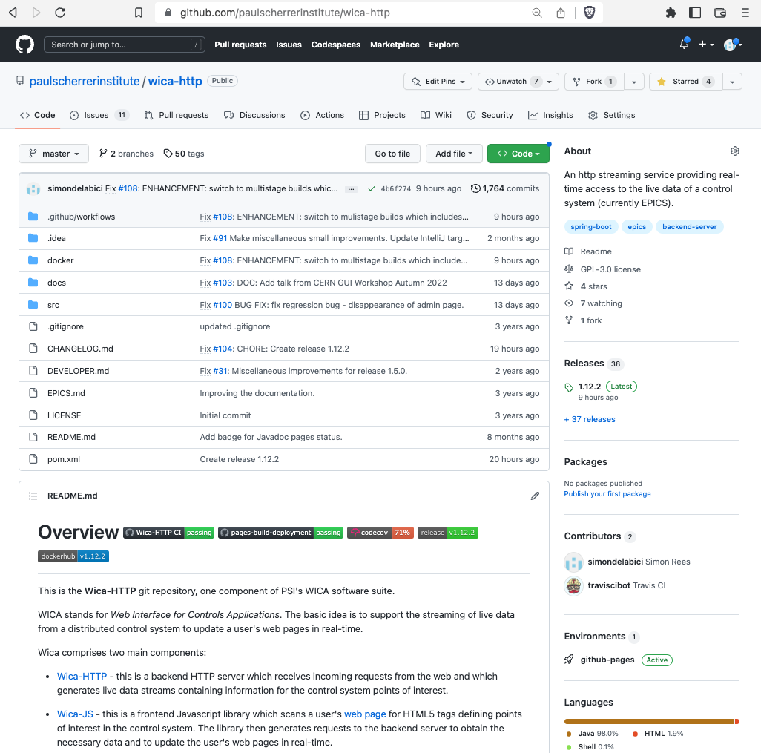
WICA Resources
GitHub Projects
https://github.com/paulscherrerinstitute/wica-http
https://github.com/paulscherrerinstitute/wica-js
PSI External Server
https://wica.psi.ch
PSI Internal Server
https://gfa-wica.psi.ch

Slide 17
Summary
WICA provides a mechanism for accessing live control system data both in and outside PSI
WICA works on phones, tablets, laptops, desktops without the need to install anything
Creating text displays can be done very easily and quickly
Richer user experiences are possible but require extra programmatic effort
Given our resource situation we need to think carefully about where they makes sense
If you want to find out more please get in touch

Slide 18
Thank you for your attention :-)
A particular thank you to
Simon Ebner for his encouragement on my learning journey Also to Daniel Lauk, ex office buddy and my web guru !

Slide 19

Bonus Slides

Slide 20
Web Projects - Challenges
Richer, state-of-the art user experiences don’t come without effort. Are our labs willing to pay that price, or do they prefer to invest the effort elsewhere ?
Rich web applications tend to be created programmatically by software developers rather than by domain experts. Software engineers are not an easily scalable resource !
Currently at PSI, we have no Web GUI builder tools to offer to our users. Such a tool would be necessarily complex (if we hope to deliver richer UX) or rely on simplifying abstractions (where we throw away some of the advantages of the web).
Users may be reluctant to give up their old GUIs, even bad ones: “better the devil you know” ! The users sometimes resist our upgrade attempts unless there is a tangible payoff for them.
We have no automatic conversion tool for our existing 5000+ caQtDm panels. Should we even create a tool which would only clone the user interface experiences of the past with their more limited richness ?
The web is still in its infancy: as we try out and discard new approaches the rate of change is far higher than with our classical software development paradigms. There is an “impedance mismatch” between the lifecycle of web technologies and the lifecycle we would wish for the components used on our machines.

Slide 21

Leveraging WICA – supported workflows
Text-only Display Page
Display Page with Text and Plots
Display Page with Text and SVG
Display Page with Camera Images
Write some html to define your control points
Write some html to define your control points
Write some html to define your control points
Obtain a Web Component that supports rendering camera image data. At PSI we use Lit
Use an SVG or text editor to create your graphic.
WICA will render the text content of your elements directly - no JS required.
Choose a JS plot library eg Plotly or Highcharts
Write some html to define the control points associated with each web component
Write some JS to update the plot using the received data
Write some JS to update the graphic using the received data

Slide 22
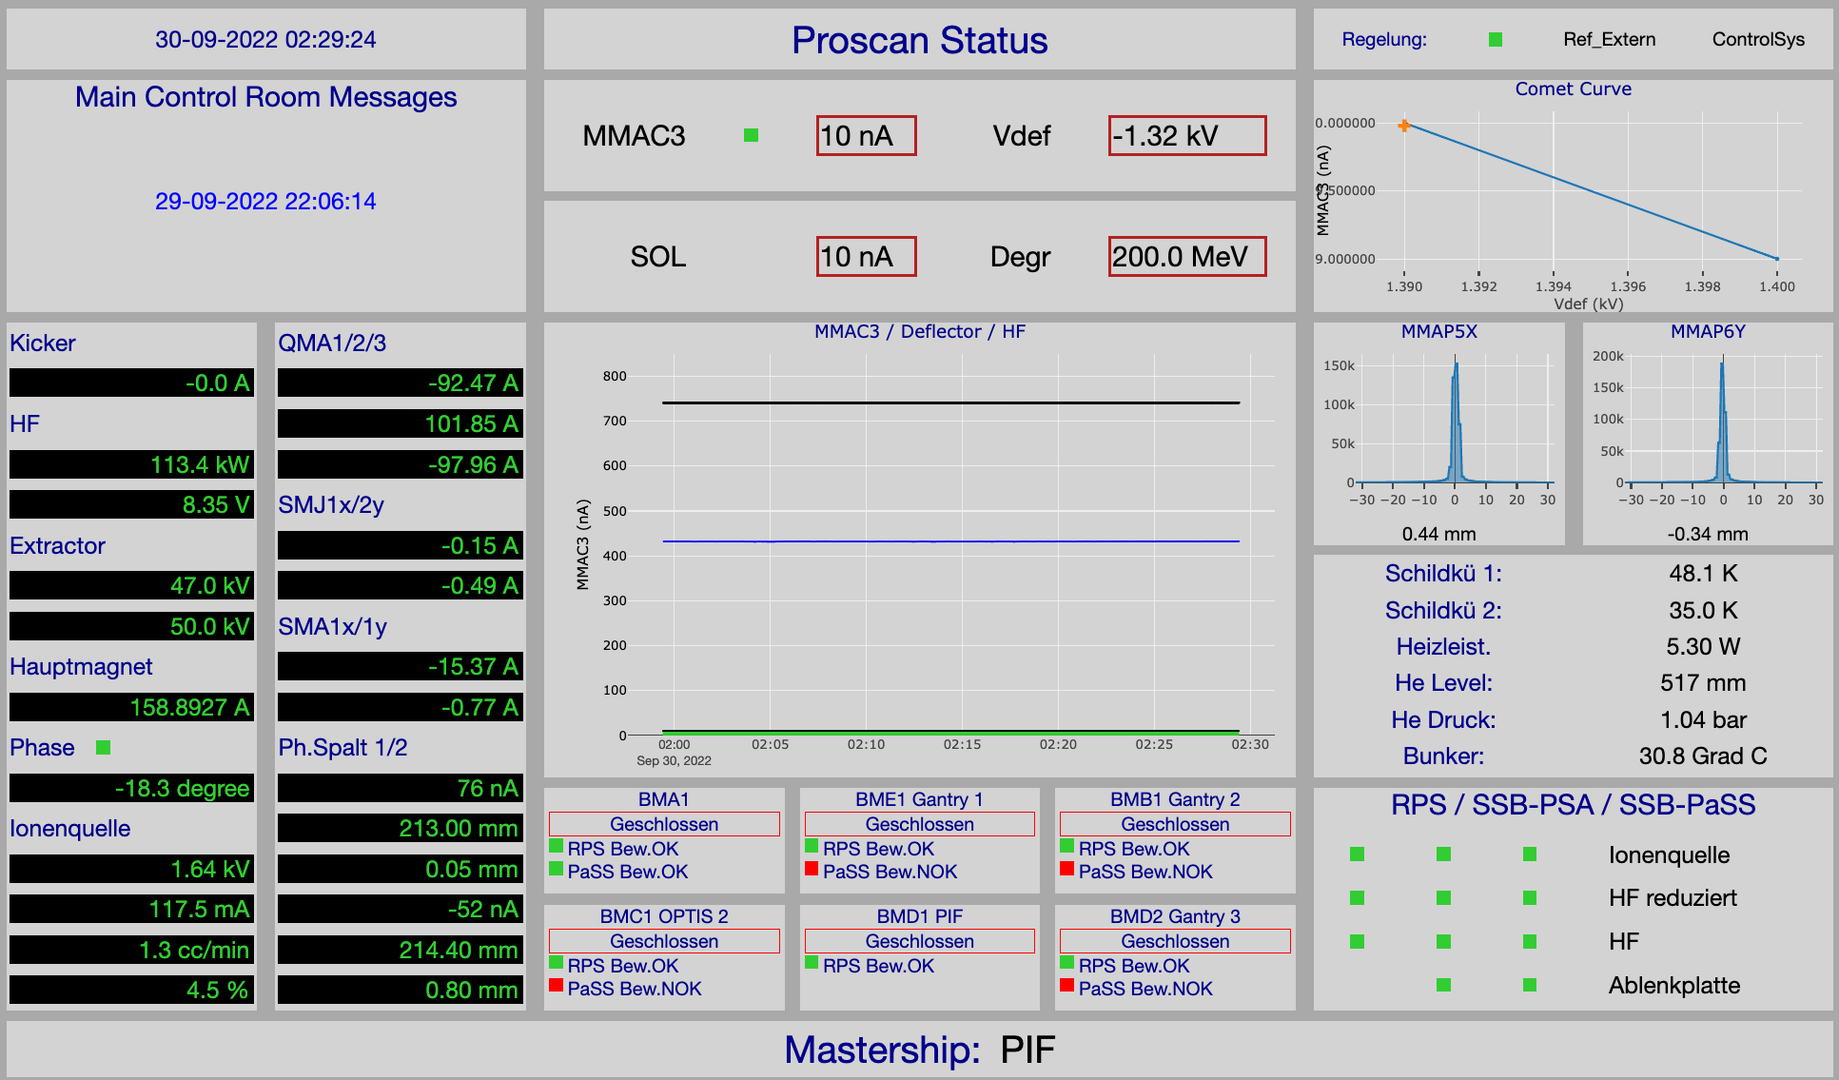

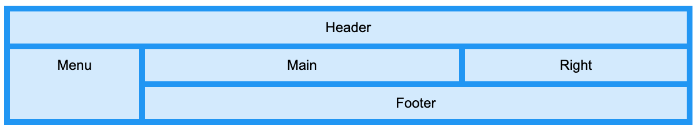
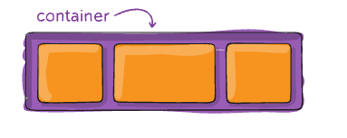
PROSCAN Status Page – Mixed Text & Plot Example
CSS3 Grid
CSS3 Flexbox

Slide 23
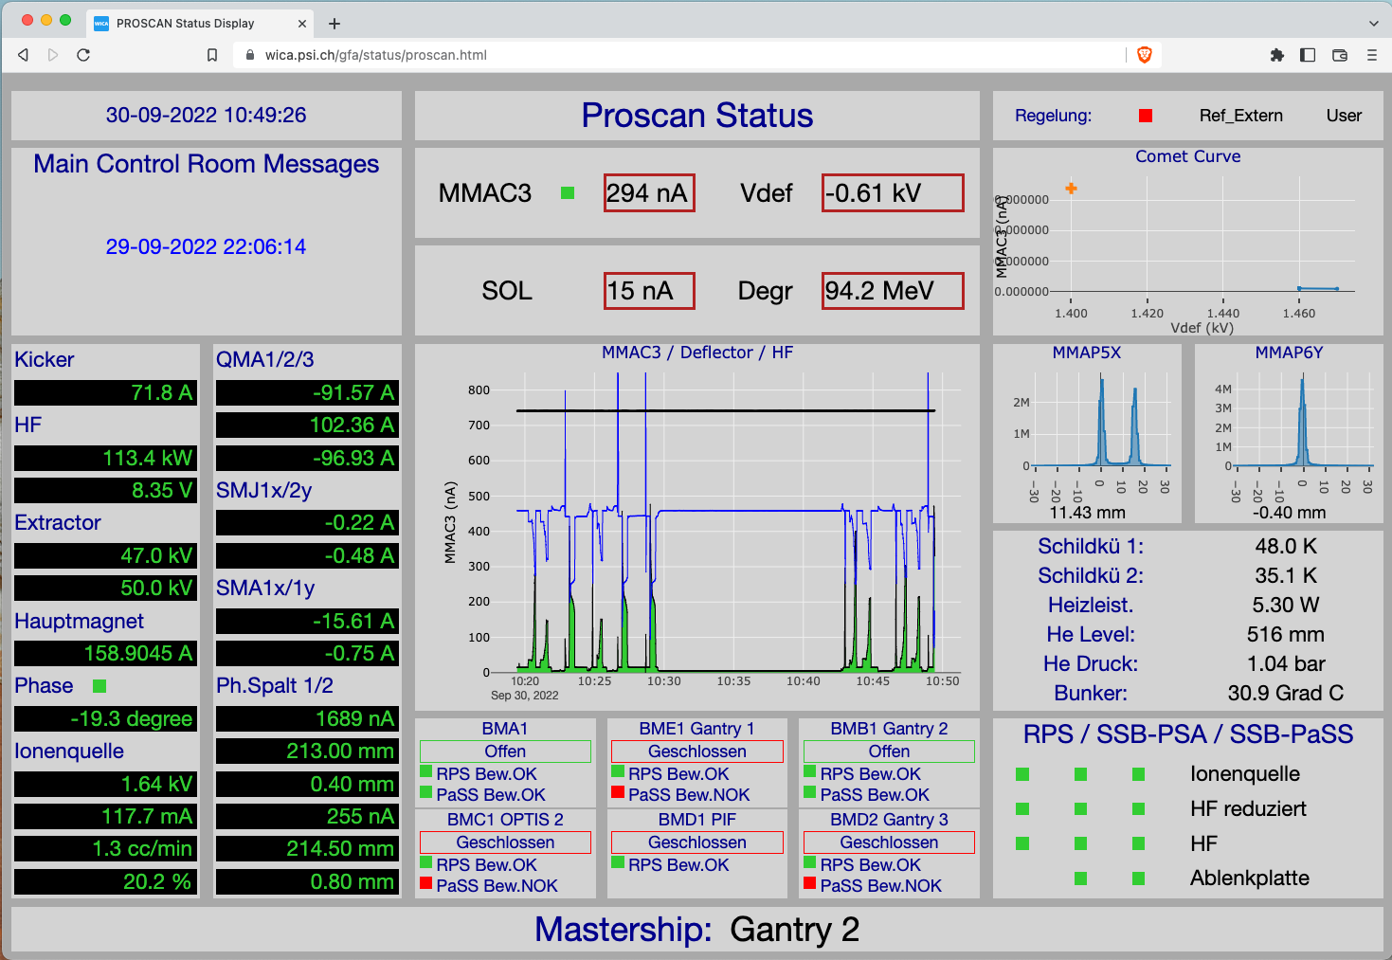
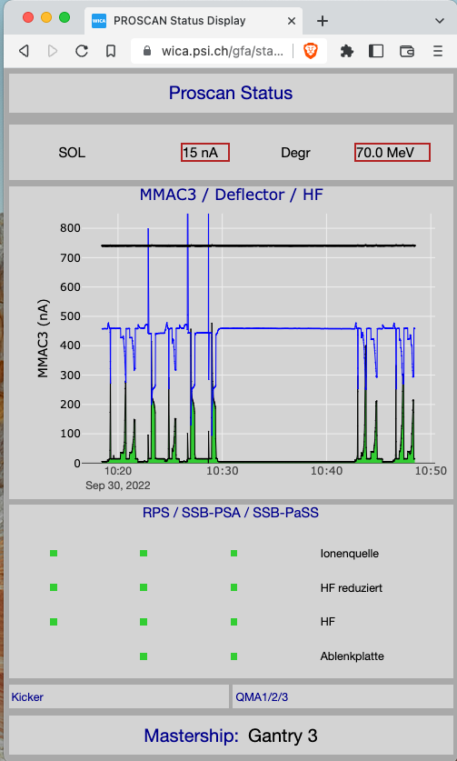
PROSCAN Status Page – responsive design
Because the pages just use normal web technology we can use CSS media queries to change the formats according to the features of the viewing device…

Slide 24

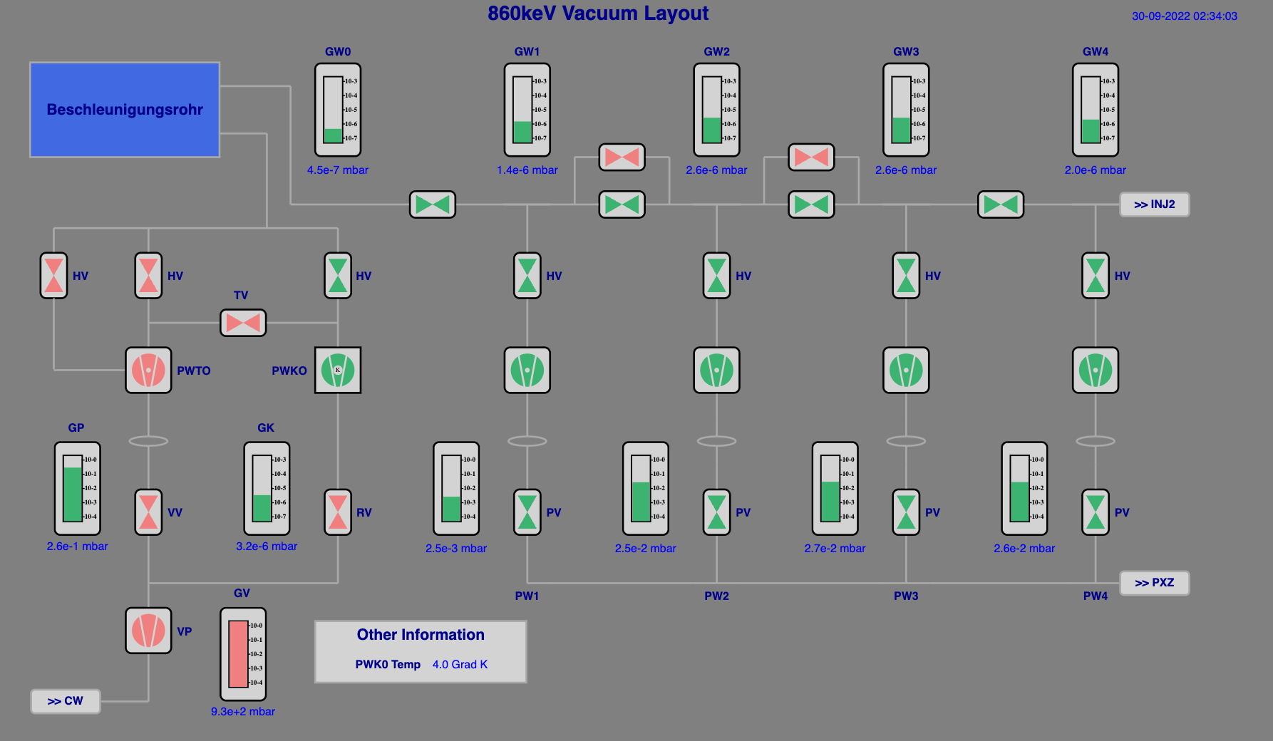

HIPA Vacuum System Page – SVG Example

Slide 25
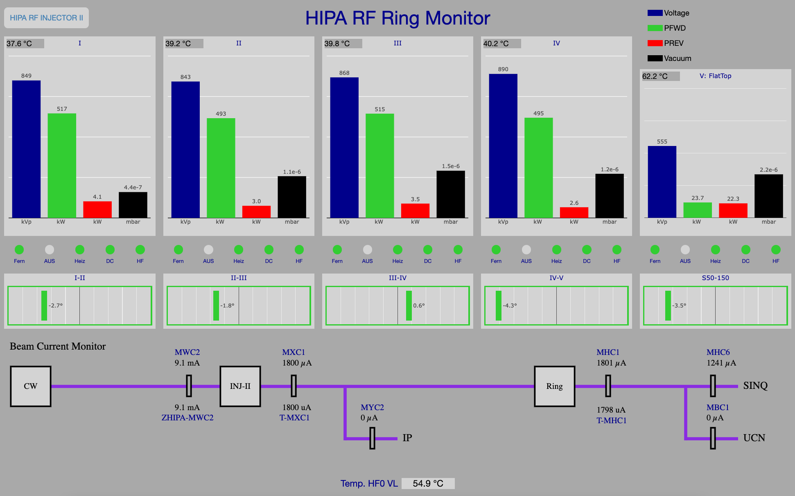
HIPA RF System Page – SVG + Plot Example

Slide 26
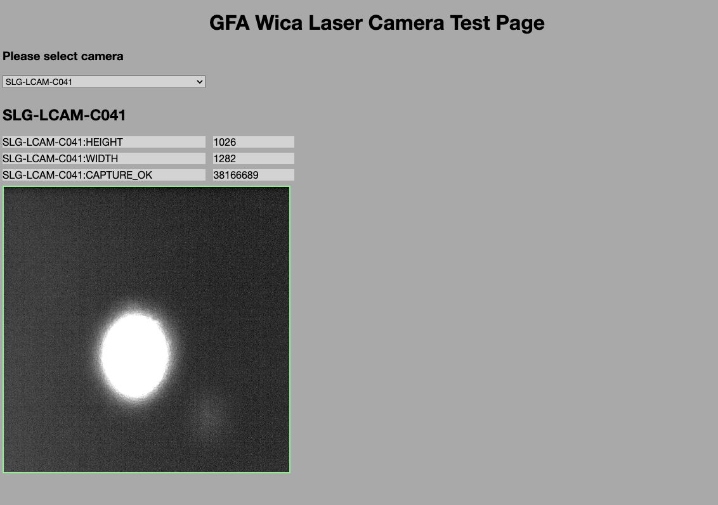

SwissFEL Camera Page – Web Component Example
Using Web Components enable us to create very clean html pages
<gfa-laser-camera-basic imageWidth="300" imageHeight="300" epicsDataChannel="SLG-LCAM-C081:FPICTURE"></gfa-laser-camera-basic>
But creating a web component control system library would require significant effort

Slide 27



WICA Overview Picture
An HTTP/EPICS gateway for accessing live control system data.
Serves EPICS live status information via HTML5 Server Sent Event (SSE) data stream.
Control System
IOC
http (POST, GET)
WICA-HTTP
Server
CA (get, monitor)
IOC
IOC
Provides the status display webpages for the control system users
Web Browser
(desktop, tablet, mobile…)
Web Server
WICA Web Pages
Uses HTML, CSS, Javascript to define the structure, appearance and dynamic behavior of the control system webpages.
Uses data-wica-* attributes to make the webpages “control system aware”.
http (GET)
WICA Web Pages
WICA-JS
Users
Observation: most of this technology is given to us “for free”– the goal is NOT to write lots of software!
A JS library for updating control system web pages, using data received from the WICA-HTTP service.
Renders the browser’s webpage to reflect live values received from the WICA-HTTP service.

Slide 28
WICA – Less is more
WICA = Web Interface for Controls Applications
Main concepts
Reflect control system points-of-interest onto html element data-* attributes
Use the received data to update text fields, plots, SVG displays, camera images etc onto the users display. This can be done in many ways.
Try to provide the users with some kind of tool or workflow so they can easily create their own displays
BYOI
“Bring your own intelligence”
Web Browser
Web Page
Intelligence
Wica-JS
JS Library
Server-Sent Event stream
REST API
Wica-HTTP EPICS Gateway
Java/Spring Boot
Learning Experiences
Partial success: WICA is the only display tool that works off-site
Getting the data to the user’s webpage is easy ☺
Providing a tool or workflow for the users (who are not programmers) has been difficult ☹
ca
EPICS IOCs
Sensors
Actuators

